Slide 1
Bug Bytes
Milestone 4 Presentation
Polus Banyameen, Maria Leon, Sydney Lum

Slide 2

Project Details
Bug bytes is a web application designed to help introduce people to coding, and provide basic, beginner lessons.
Different types of questions (Multiple choice, sample code, etc.)
Their progress is tracked through their account, saved on MySQL, with servers hosted by Apache Maven.
The user is also given an ape companion to help them throughout their lessons
Can customize with coins earned through play time.

Slide 3
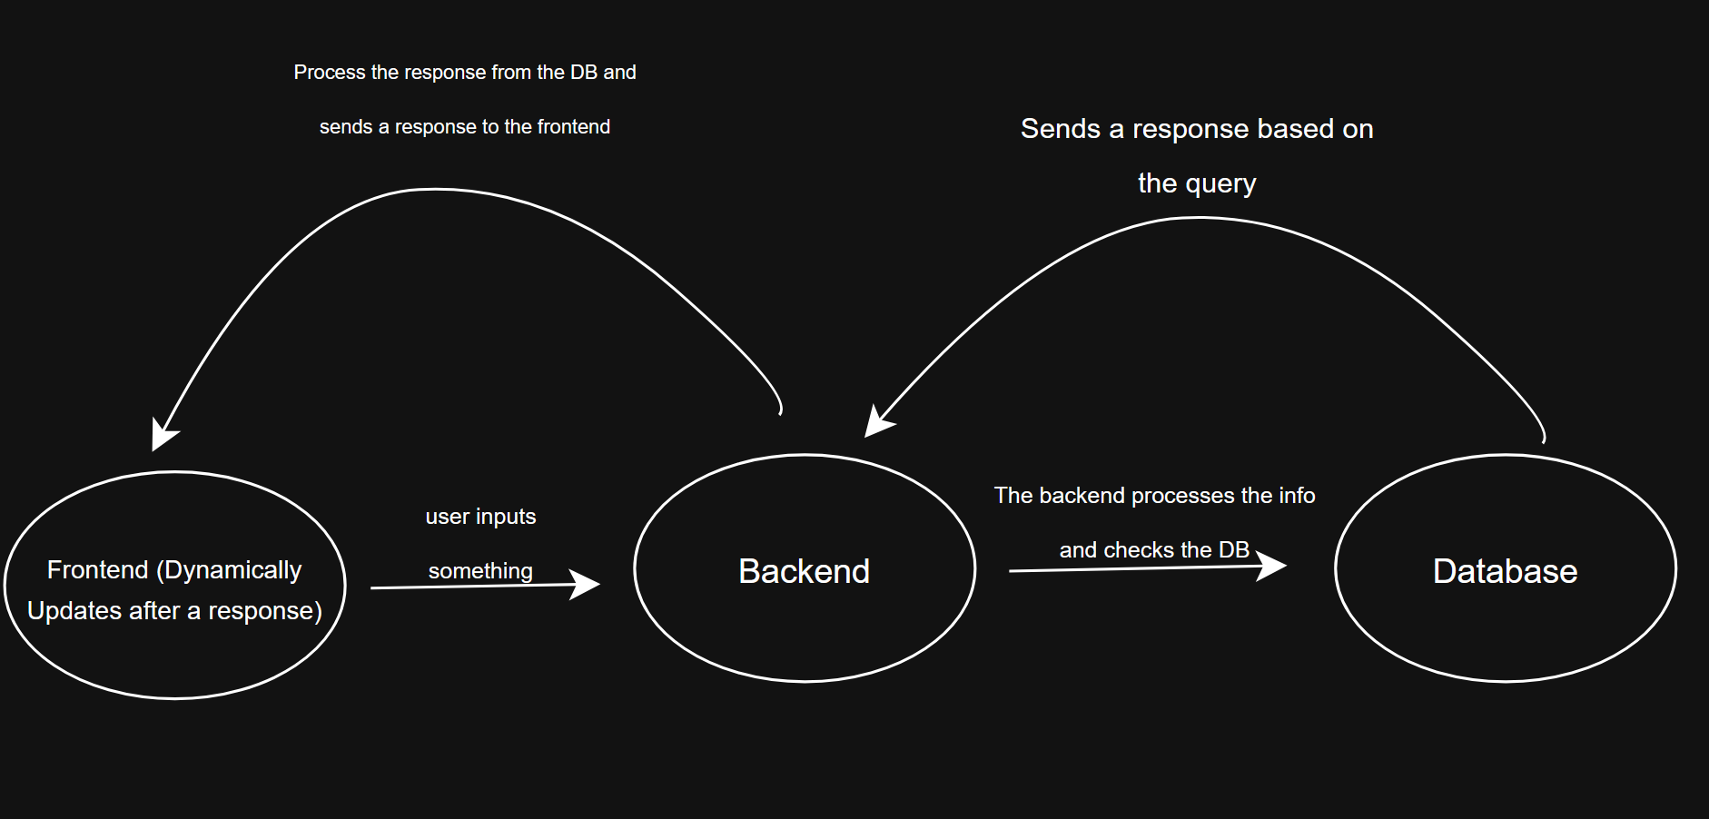
Diagram 1 (Architecture)

Slide 4
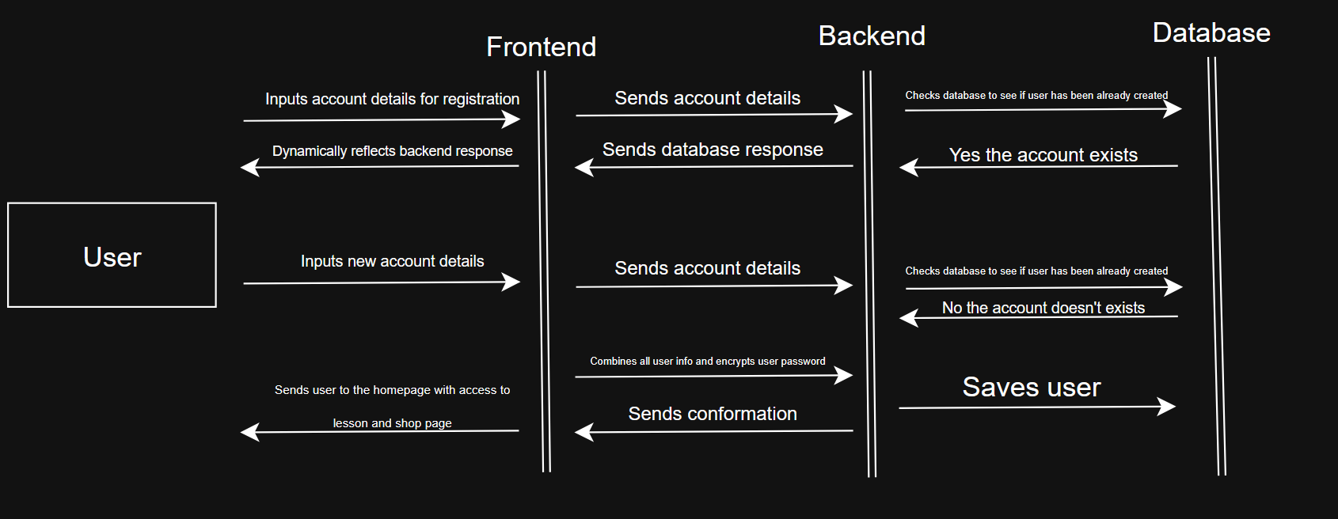
Diagram 2 (User trying to Register)

Slide 5
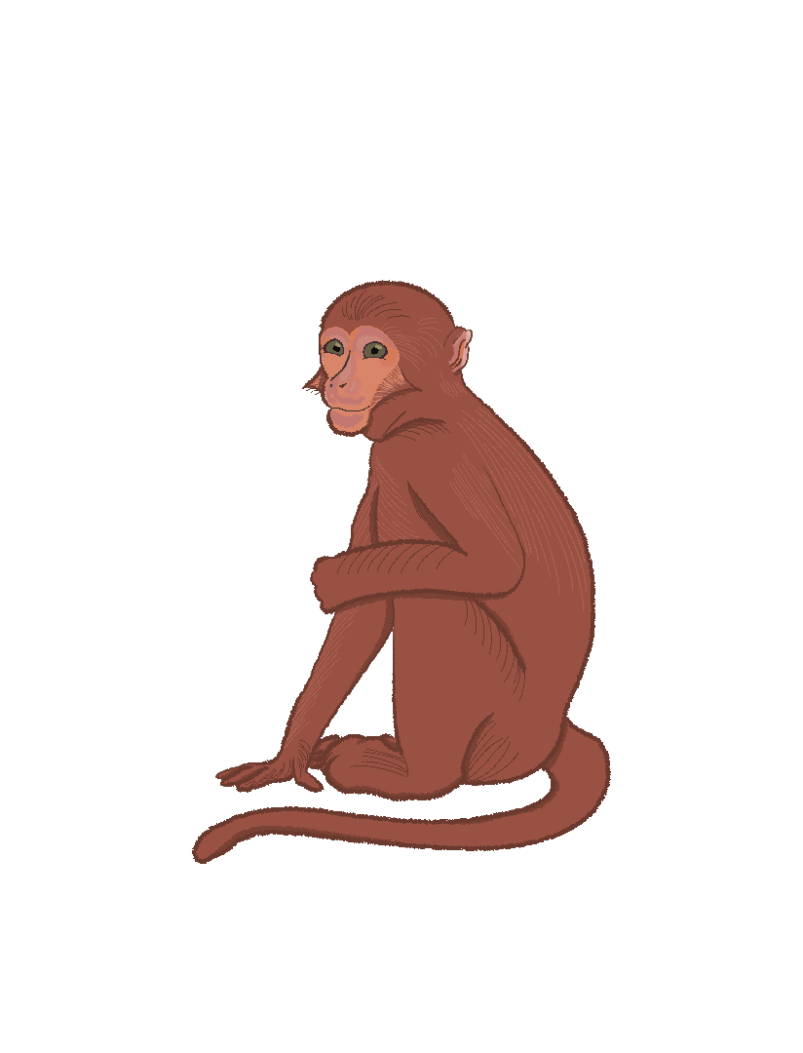
Requirements
Requirement 1: a lesson plan that includes questions to test the user on what they learned
login/registration page
Requirement 2: a strong backend that manages question checking, account handling, and progression
Saving data in MySQL, compiling code
Requirement 3: a store-tied to account progression, allowing users to customize their ape companion
Correct answer = Coins

Slide 6
Ethical Impact
Bug Bytes is designed to help those who want to start coding get familiar with the basics of Java. This will provide a starting point for those who are struggling to find a way to learn. Through this platform, users can access informative resources and practice their foundational Java skills.
Protect confidential user information and user data
Bcrypt- encrypt passwords, protect against leaks, security
Guarantee accurate and up-to-date information
By maintaining accuracy, we can genuinely support our users in their learning journey

Slide 7

Technology Used
JavaScript - Frontend functionality
Prism for the code segment look
HTML/CSS
Java (Spring Boot)
Some dependencies include: starter security, MySQL connector, and devtools
MySQL
GitHub
Git
IntelliJ
Visual Studio Code
Terminal
Procreate

Slide 8
Demo

